Slide 1
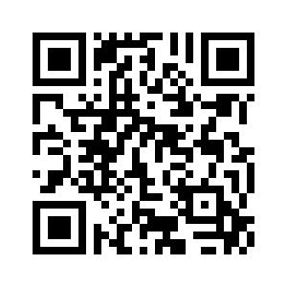
We Care Program Overview
Food Pantry
ASB 130
Open to Faculty, Staff and Students
Fresh Food Distribution
Satellite Pantries
10 pantries located around campus
Student Relief Fund
Laptop Upcycle Program
Professional Clothing Closet

Slide 2
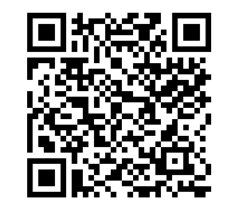
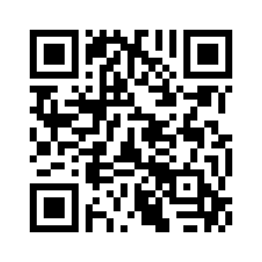
Donations and Statistics
Single Donation to the Student Relief Fund
Payroll Deduction Form
Spring 2024 Survey- 51% of students reported experiencing some level of food insecurity.
300 students have received more than $95,000 from the fund since 2017.
The We Care Program is funded entirely through donations and grants. The program has received nearly $200,000 in grant funding since 2023.

