Slide 1
FY25 Faculty Assembly
April 24, 2024

Slide 2

Budget & Planning Cycle
Board of Trustees (BOT) approves budget, tuition, room & board rates
Final budget for BOT review
New Fiscal Year
Units receive new budget
Open Forum Present budget to community
President’s State of The College Address
Mission Element Team reviews budget
Assumptions tested, pro forma drafted
Budget training for unit directors
Budget Change requests submitted in Adaptive
Submit budget request to NJ OMB
Jun
Jul
Aug
Sep
Oct
Nov
Dec
Jan
Feb
Mar
Apr
May
Jun
Start
Units assess and adjust current budget/strategies throughout the year
End
Repeat

Slide 3
Principles of Budget Development
Resources focused on the Mission of the College – commitment to academic excellence
Planned use of resources will not exceed estimated resources available
College is committed to maintaining resources in order to sustain overall financial health
Focus is a Balanced Budget

Slide 4
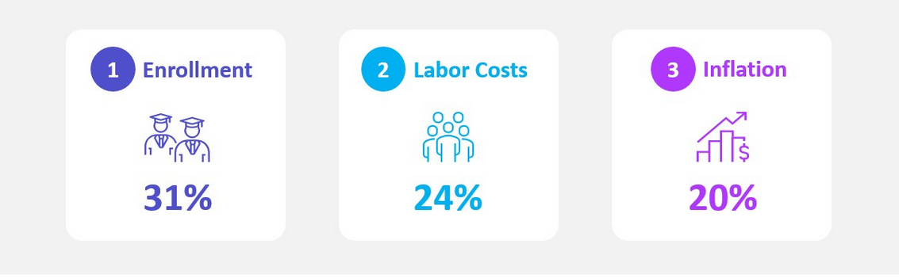
Top 3 Challenges Over the Next 5-10 Years
Ranking by financial leaders based on greatest financial impact:
Source: Syntellis’ 2023 CFO Outlook for Higher Education

Slide 5
Value Proposition of a 4-Year Degree
Value and cost of education
Student debt levels
Graduation rates and retention challenges
      Mental Health issues
      Skills Gap for some students
Increased post high school graduation alternatives
  Gap Years
  Straight to Jobs
  Apprenticeships
Employment environment post graduation
Shortages – Teachers, nurses, trades and counselors (graduate programs)

Slide 6
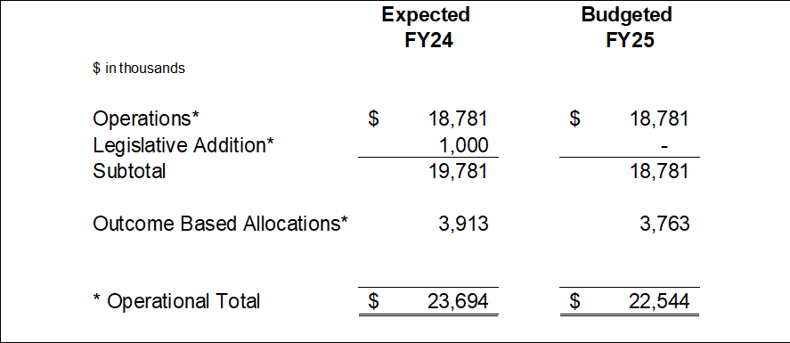
Ramapo’s State Appropriations
Source: March 2023 internal financial statements
Notes:
Updated 4/23/24

Slide 7
Annualized Enrollment: FTE
Undergraduate is Fall and Spring enrollment, Graduate is full year enrollment. *Includes Ramapo @ PCCC
Notes:
^{BG 4/19/24}

Slide 8
FY25 Budget

Slide 9
FY25 Budget Assumptions
Currently modeling a 3-5% increase for both tuition and housing rates (in state tuition moves to $8,228-$8,398 semester/$16,456-$16,797 annually).
Major factors impacting this rate include:
• State appropriations slightly lower than prior year
• Inflation rates and CPI continue to increase through February 2024
• Union contracts finalized with 3.5% COLA and approximately 3.5% step increases annually
• Tuition increases in FY24 at NJ peers: TCNJ 4%, WPU 3.6%, Rowan 5%, Stockton, 2.26%, Montclair 7.3%
• Full Pell and Full Tag increasing to $16,891; Ramapo’s most disadvantaged population will be
fully covered
• Full-time fringe rate budgeted at 85%, currently up from 77%

Slide 10
FY25 Budget Assumptions
• Tuition waivers up approximately 17% from FY24 actuals
• Undergraduate enrollment (FTE) for FY25 Fall is budgeted 4.4% higher than
FY24 Fall actuals. Ability to estimate significantly impacted by FAFSA delays
• Graduate enrollment (credit hours) is budgeted to decrease for FY25 compared to FY24 actuals
• Housing for FY25 Fall and Spring is budgeted at 72.7% average occupancy
as compared to FY24 which had an approximate occupancy of 69.3%
• Deliberate position review and controls, significant number of positions frozen

Slide 11
Budget Development
Housing projections
Rental income
Supply
Chain
Salary increases
Utility costs
Unit Plans/Needs
Economy
Enrollment trends
State Legislation
State Funding
Planning
Strategic Priorities
Teamwork
Balanced Budget

Slide 12
Financial Summary

Slide 13
All Hands On Deck
    Boldly Ascending Strategic Plan
    Comprehensive Facilities Plan
    Comprehensive Academic Plan
Enrollment Strategies
    Maintain strong enrollment management efforts/evaluate student discount model
    Assess market, needs of students (financial, academic, & support)
    Continue efforts to maintain strong retention
    Partnerships with two year institutions
Diversified Revenue Streams
  PNP
  Grants
    Rental Income and Summer Revenue

Slide 14
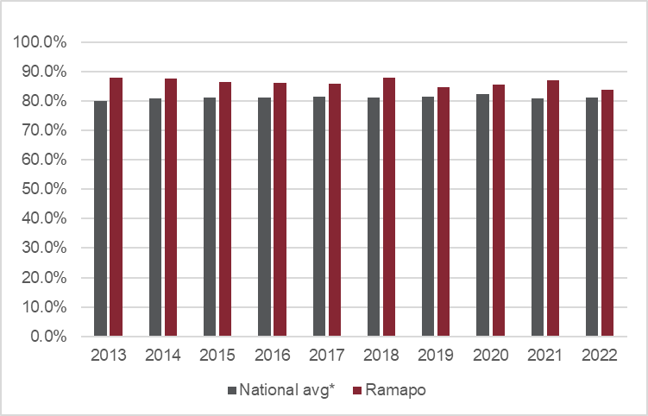
Second Year Retention
Public, 4-year or above*

Slide 15
Second Semester Retention
Fall 2022 – Spring 2023, semester to semester retention returned to pre-pandemic levels

Slide 16
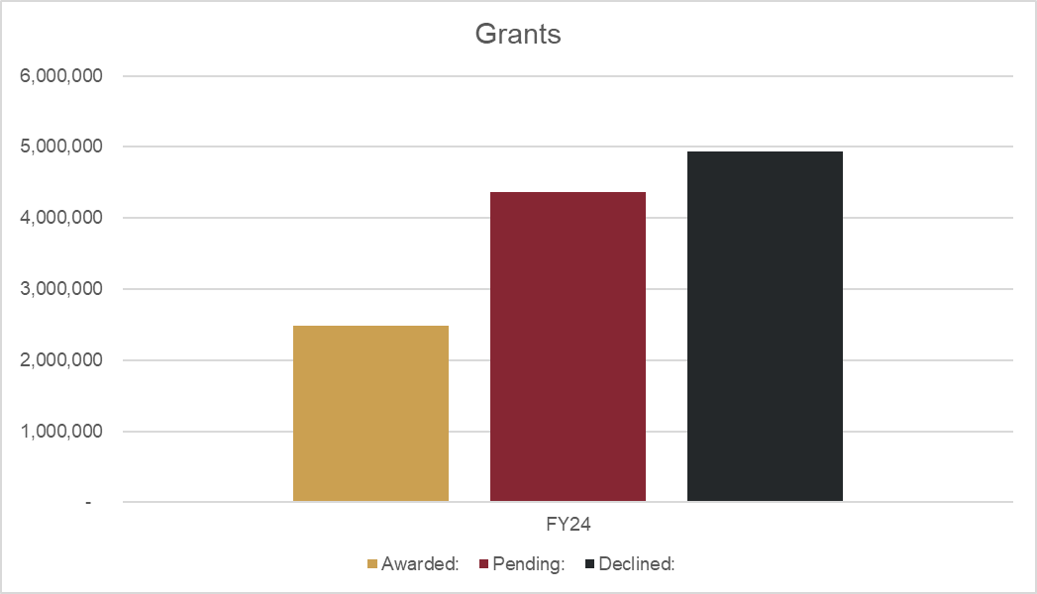
FY24 Grant Submissions

Slide 17

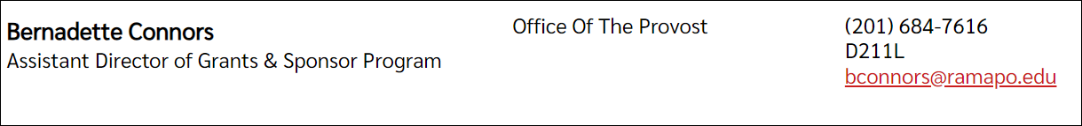
Grant Resources
https://www.ramapo.edu/grants/
Grants Accountant
Assistant Director of Grants & Sponsored Programs

Slide 18
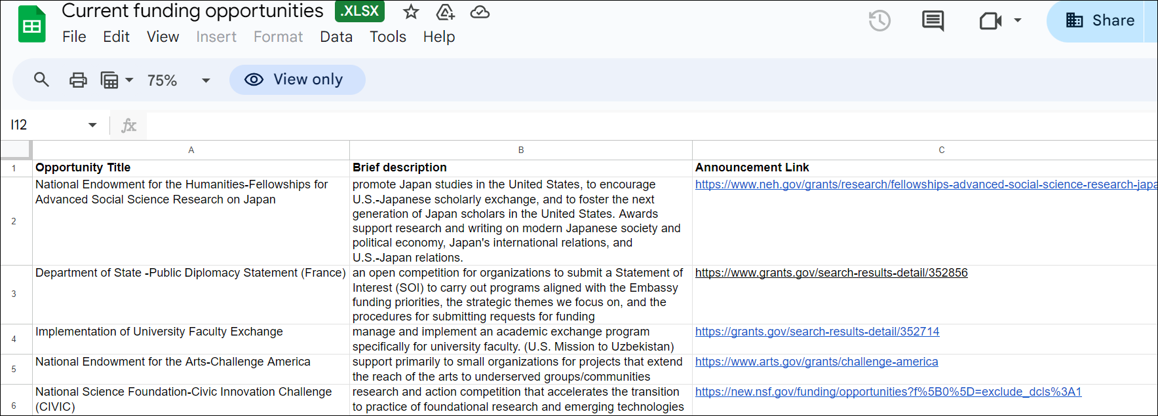
Grant Resources

Slide 19

What can We do for Our College?
Participate (unit effectiveness and assessment, Commencement, support student events)
Innovate (opportunities for new revenue streams, new programs, better ways to do things)
Manage Prudently (opportunities for cost savings)
Act with Purpose towards Boldly Ascending
Be Bold, Be Kind, Be a Good Teammate
“As an institution, we can position ourselves on the leading edge of change if we are brave enough to ask: What’s next? We are not to be complacent, but always stretching, being bold, prudently accepting risk, while always grounded in our values in our students’ best interest. This mindset must permeate at all levels. Ramapo College’s mission, vision and values are powerful and they give us the space to be bold.”
Cindy R. Jebb, Ph.D

Slide 20
Questions?

Slide 21
Thank you!

