Slide 1
Academic and Curricular Guidelines Manual
2023-2024
Catalin Martin (TAS - Chair), Carol Bowman (SSHS), Mark Skrowronski (ASB), Samantha Wittenberg (LIB), Pinar Kayaalp (HGS), Meredith Davis (CA), Susan Hangen (Vice Provost), Jeneen Kelly (Registrar’s Office), John Yao (Center for Student Success)
ARC is thankful for valuable discussions, information, feedback or initial work on the manual to many colleagues: Provost Middleton, Vanessa Arriola, Michael Unger, Ken McMurdy, David Oh, Diane Couzens, Christina Connor

Slide 2
Rationale for Revisions
Reinvigorate a robust review process, in a highly collaborative manner, with broad engagement at the appropriate levels (optimizing the product): We would like ARC to not just give an YES or NO verdict on a proposal, but rather facilitate a broader dialog about the proposal at this step of the curriculum review process, to better understand its implications beyond a convening group or a particular program, to generate a better product.
Ramapo College's curriculum review process must align with the standards, expectations and levels of scrutiny that the New Jersey Presidents’ Council (NJPC), through its Academic Issues Committee (AIC), will demand. One of the objectives of the new manual is to bring greater alignment with state standards and at an earlier stage, so that there is less duplicated work and prep time post-ARC/Provost approval.
Seamlessly integrate our process with the Course Dog system and take full advantage of that technology.
Notes:
ARC is the “voice of the faculty” in the curriculum review process, but we also need to understand that it is just one of the steps, and there are different layers of review: provost’s office, registrar’s, student success, BOT, State, etc. We would like to “help optimize and make a better product”.
Usually, a proposal is submitted to ARC in the fall and it takes almost a semester to move past ARC/FA approval, for submitters to realize that only then they need to start the work for aligning the proposal with the external requirements.

Slide 3
Technical/Structural Changes to the ARC Manual
Removed the history section of the ARC from the manual. A separate document will be posted on the ARC webpage.
Removed the syllabus check-list and syllabus template from the manual. These will be posted separately on the ARC webpage and we hope to create a fillable syllabus template with support from the IT department.
Removed all ARC forms (New Course Proposal, Course Revisions, New Program Proposal, Program Revisions, etc.) from the manual. Once the CourseDog system will be adopted, these forms will be filled online, and the appropriate levels of approvals will be checked/signed online. Until then, the forms will be available for download from the ARC page, in the current form.
The hard deadlines were removed, ARC will accept proposals (all categories) on a rolling base, pending that the proposal is complete. ARC representatives and the chair will work with submitters to check for all requirements before placing the proposal on the agenda for review.
ARC Decision Options:
Endorse: Everything is in order and a majority of ARC members have voted to approve the proposal.
Revise: ARC has identified concerns or significant potential issues and the proposal is sent back for revisions. The proposal may be resubmitted after revision.
Reject: The proposal does not align with mission of the college, or does not have the required capabilities or the curricular needs to operate successfully, or overlap substantially with other programs, etc. A majority of ARC members have voted to reject the proposal.

Slide 4
I. New Course Proposal and Revisions
For new course proposals, the manual insists on communication and consultation at the convening and school level. The creation of a new course or modification of an existing one can sometimes have implications beyond a specific program or convening group. Conveners and Deans should discuss implications on other programs before signing the ARC form.
For course revisions, the manual attempts to provide more clear guidance and examples on what represents major curricular changes that require ARC review and what are considered minor or rather administrative changes, hence do not require ARC review.

Slide 5
II. New Program Proposals
The manual provides guidance on how to initiate a new program proposal: what information is required to gather and what the process is. It includes links to the Academic Issues Committee (AIC) manual, the AIC standards for new degree programs, review and approval levels.
It includes the flow chart of information and the required reviews/approvals through the online (CourseDog) system.
The ARC Chart, describing the proposal development and reviews has been updated.
Aligns the ARC requirements and the proposal package submitted to ARC with the requirements and documentation to be submitted for state approval.

Slide 6
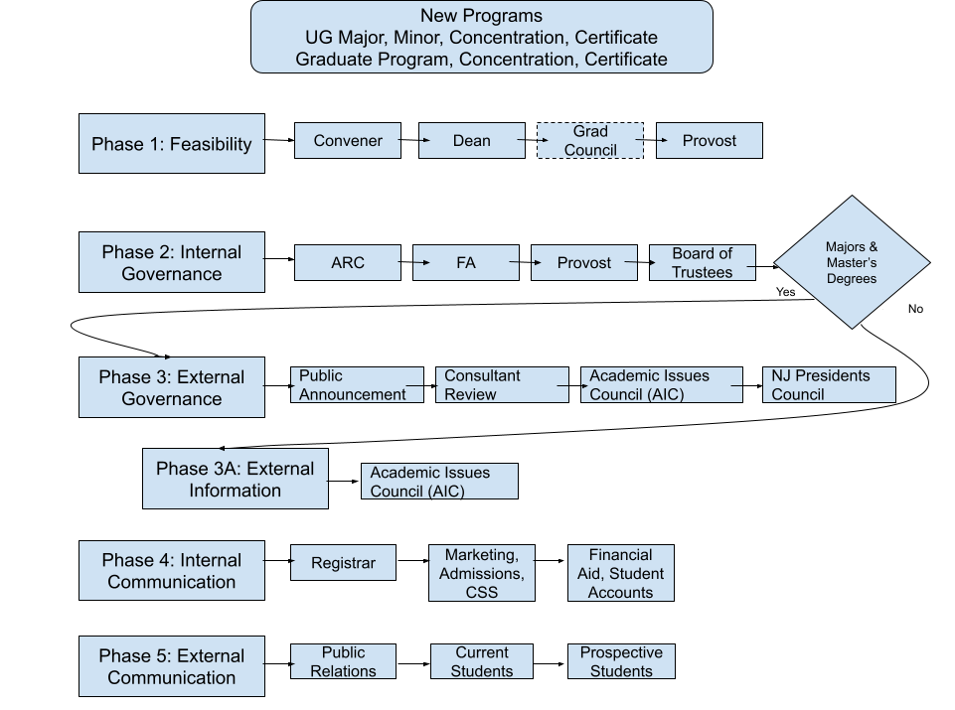
The Required Approvals Chart (CourseDog)

Slide 7
The ARC Chart

Slide 8
The ARC Chart
Feasibility Phase
Faculty, Conveners and/or Deans discuss the new program idea and collect the data required. Communication with other Schools that may be involved and/or affected by the new program is highly recommended. Consultation with the Provost Office will also help understand the administration’s overall optics of the new program. If there is compelling evidence for the merit of the new program, and most parties involved view it positively, the work on preparing the proposal can start.
Make sure to study carefully the AIC document: STANDARDS FOR NEW ACADEMIC DEGREE PROGRAMS/FORM FOR INSTITUTIONS SUBMITTING PROPOSALS: https://www.njpc.org/aic/new-academic-degree-programs/
Convener(s) ensure that the proposal was collectively reviewed and holds a vote on the proposal, before signing it through the online system.
Unit Curriculum Committee (UCC), if it exists, review the proposal. If the unit does not have a UCC, the Dean ensures that the proposal is shared and reviewed across the School(s), well in advance of the vote at unit council meeting. Dean approves the proposal through the online system.
Proposal advances to the Provost Office for feasibility review. Graduate Programs also need the approval of the Grad. Council

Slide 9
The ARC Chart
2. Curricular Phase:
Internal Approval
Once the Provost signs (electronically) the Feasibility Phase Checklist, the full proposal package advances to ARC.
ARC reviews the proposal.
If approved by ARC, the proposal advances to the FAEC.
FAEC schedules the proposal for a vote at the FA meeting
If approved by the FA, proposal advances to the Provost Office for provost approval
If approved by the Provost, the proposal is sent to the Board of Trustees

