Slide 1
ARC is working on the necessary revisions to the manual in order to:
Align with the revised process and requirements for new program proposals of the NJ Academic Issues Committee (AIC).
Align with the new electronic platform (CourseDog) which will be adopted by the college.
Provide appropriate guidance to those submitting proposals on the following:
- process
- requirements of a proposal
- timeline

Slide 2
ARC is working on the necessary revisions to the manual in order to:
Align with the revised process and requirements for new program proposals of the NJ Academic Issues Committee (AIC).
https://www.njpc.org/wp-content/uploads/2024/02/AIC-Manual-02.21.2024-FINAL.pdf

Slide 3
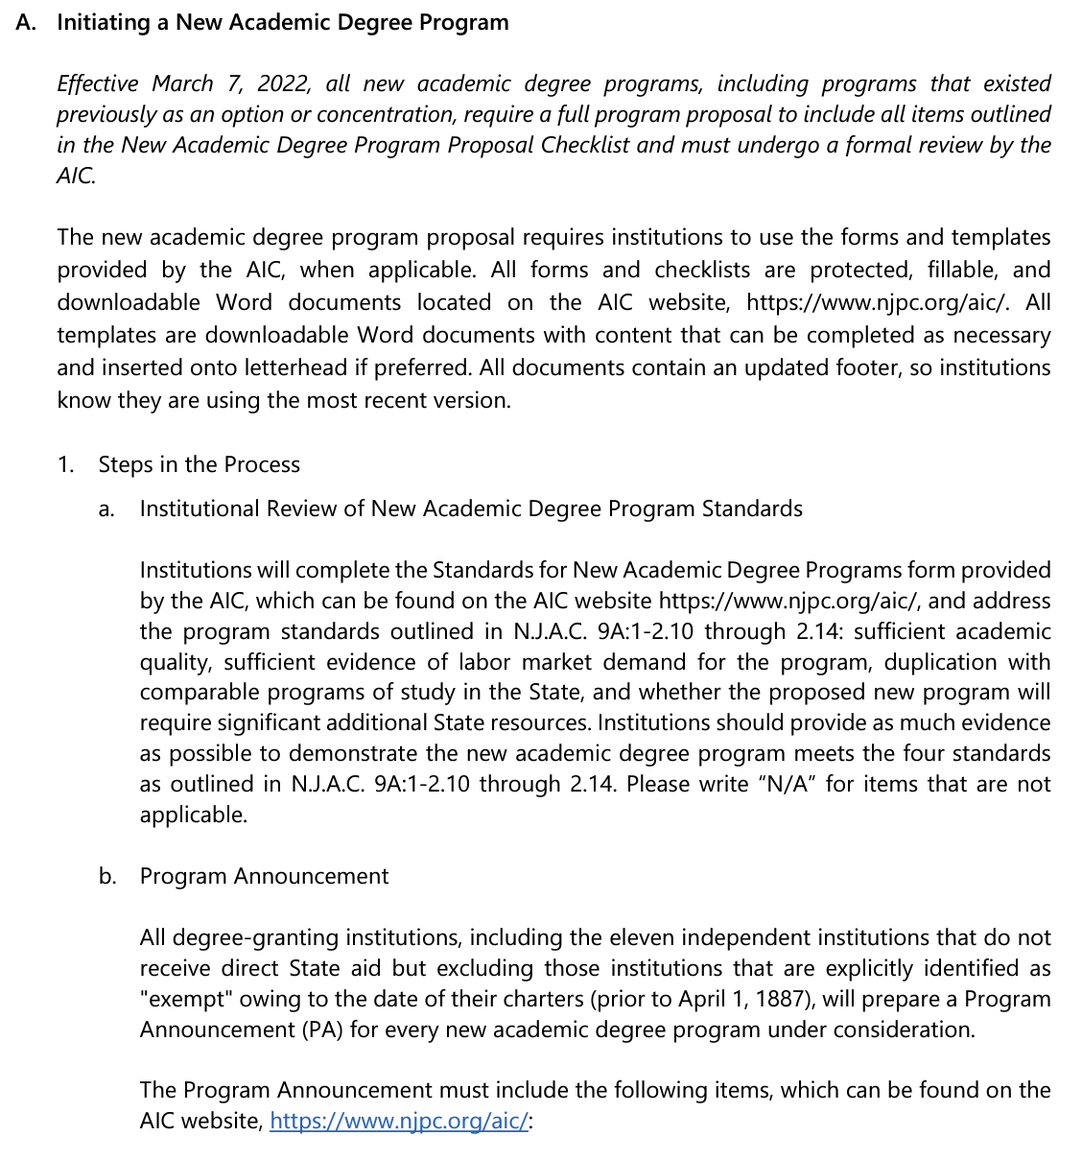
ARC is working on the necessary revisions to the manual in order to:
Align with the revised process and requirements for new program proposals of the NJ Academic Issues Committee (AIC).
https://www.njpc.org/wp-content/uploads/2024/02/AIC-Manual-02.21.2024-FINAL.pdf

Slide 4
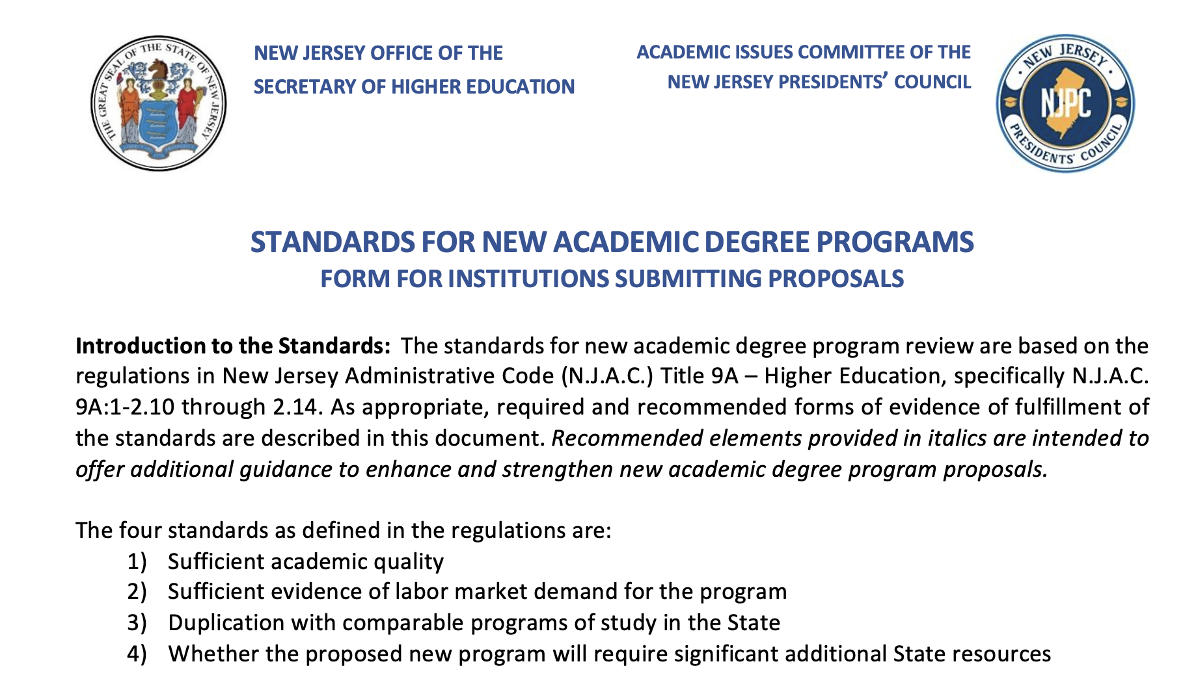
ARC is working on the necessary revisions to the manual in order to:
Align with the revised process and requirements for new program proposals of the NJ Academic Issues Committee (AIC).

Slide 6
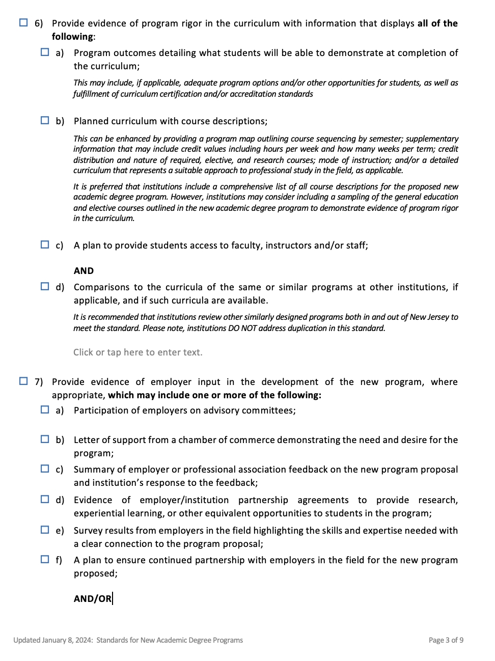

Slide 7
